Slide 1

Stages Insights 2016
from ARIS to
an interesting and educational journey into Process Management
Walter DÜRR
Product Assurance
RUAG Space GmbH
Vienna, Austria

Slide 2
AGENDA
Brief introduction of RUAG Space
Process Management – the beginning
Why to change the process modelling tool?
Process conversion from ARIS to stages
Main map and PDP concept
Current and upcoming challenges

Slide 3
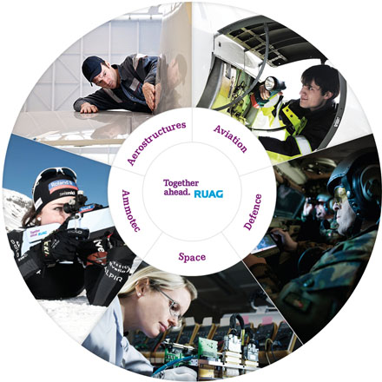
RUAG at a glance
Innovation-driven international technology group
Sites in: CH, DE, AT, SE, FIN, HU, USA, AUS
Sales 2014: 1482 M€
8100 employees (end 2014)
Joint stock company under private law since 1999
Shareholder: The Swiss Confederation
Headquarters: Berne (CH)

Slide 4
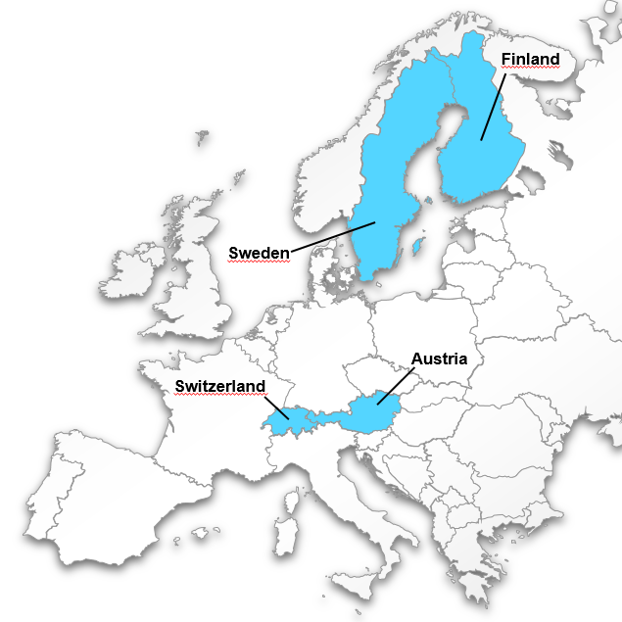
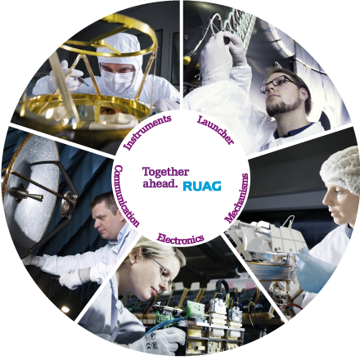
RUAG Space at a glance
Leading European space product supplier to the industry
Eight sites in four countries (Switzerland, Sweden, Finland, Austria)
US office in Denver, Colorado
1158 employees (end 2014)
Total revenues (2014): 265 M€
Headquarters: Zurich (CH)

Slide 5
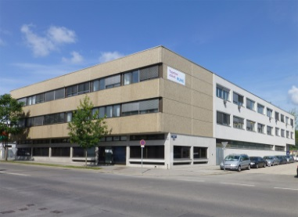
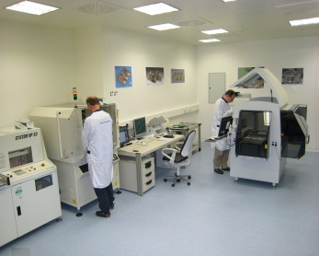
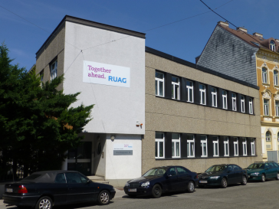
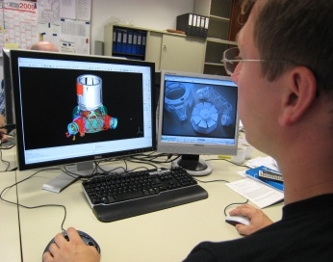
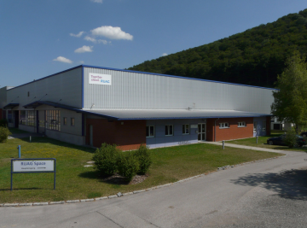
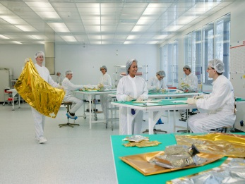
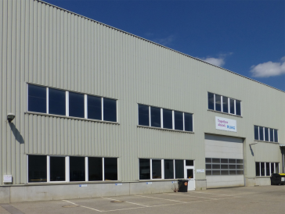
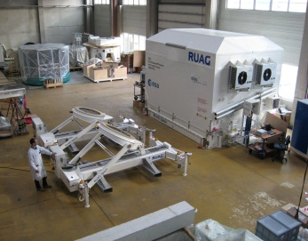
RUAG Space in Austria (RSA) at a glance
“A global partner for first-class satellite equipment”
Facts & Figures
  Employees: 203
  Sales 2014: 36 M€
  Owner: RUAG Holding
Head Office, Vienna
  2 buildings
    offices, laboratories, workshops
    cleanrooms (class 100.000, 400m²)
  Integration hall
Manufacturing Facility, Berndorf
  Production of Thermal Hardware
  Cleanroom (class 10.000, 300m²)
ISO 9001, EN 9100 and ISO 14001 certified

Slide 6
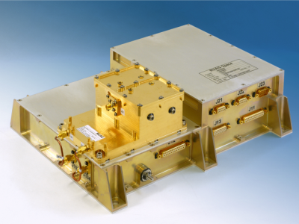
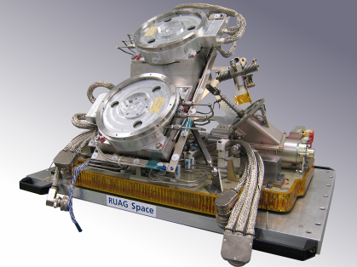
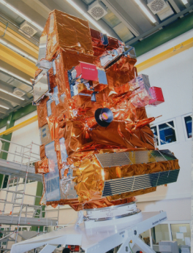
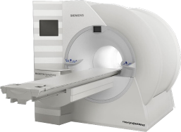
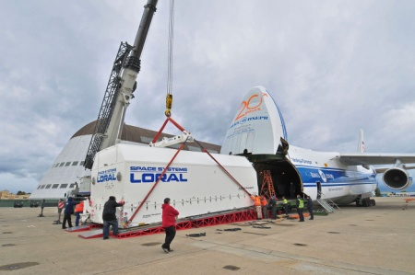
Areas of Competence in Austria
On-board Electronics
  Navigation receivers and
  interface electronics
On-board Mechanisms
  Pointing and deployment
Thermal Systems
  Space and non-space insulation
MGSE
  Containers, trolleys, system MGSE, etc.

Slide 7
RSA Space Program Contributions
ABRIXAS
AEOLUS
ALPHASAT
AMOS
ANIK-E
ARABSAT
ARIANE V
ARTEMIS
ASTRA
BEPI COLOMBO
CHEOPS
CLUSTER
CRYOSAT
EARTHCARE
EDRS-C
ENVISAT
EROS
ERS-1,-2
EUCLID
EURASIASAT
EURECA-AMF
EUROSTAR 3000
EUTELSAT W-24
EXOMARS Rover
EXOMARS Orbiter
GAIA
GALILEO IOV, FOC
GEO-Kompsat-2 A/B
GIOVE-A,-B
GIOTTO
GOCE
GOKTURK
HERSCHEL/PLANCK
HISPASAT
HUYGENS PROBE
ICESAT-2
INMARSAT-4
INTEGRAL
IRIDIUM-NEXT
ISO
ITALSAT
JASON-CS
MARS EXPRESS
METEOSAT 2nd Gen.
METEOSAT 3rd Gen.
METOP 1st Gen.
METOP 2nd Gen.
MMS
NPOESS
ODIN
OLYMPUS
PLEIADES
PROTEUS
RBSP
ROSAT
ROSETTA
SARLUPE
SENTINEL-1,-2,-3
SENTINEL-4
SENTINEL-5P
SIRIUS
SMALL GEO
SMART-1
SMOS
SPOT
SOHO
SOLAR ORBITER
SWARM
TANDEM-X
TERRASAR-X, -L
ULYSSES
VENUS EXPRESS
XMM
        ➔ more than 30 years experience in space

Slide 8

RSA‘s Major Space Program Customers
Airbus D&S
CASA Espacio
CGS
CNES
Dutch Space
ESA / ESTEC
EUMETSAT
Jena Optronik
Kayser-Threde
Mier
USA / Canada
Air Force Research Lab
Ball Aerospace
Boeing Satellite Systems
Johns Hopkins University
MacDonald Dettwiler Ass.
NASA/NOAA/DoD
Northrop Grumman
Orbital Sciences
Space Systems Loral
Europe
Asia
CAST
IAI/MBT
ISRO
JAXA
KARI
MELCO
OHB
RUAG Space AB
RUAG Space AG
Sabca
Selex Galileo
Sener
Snecma
SSTL
Tesat
Thales Alenia Space
        ➔ appreciation of customers world-wide

Slide 9
Process Management – the beginning (1999-2001)
Goal
To establish a Process Management System (PMS) covering all processes needed to run the organisation, which is certified according to ISO 9001 and ISO 14001.
Key Characteristics
PMS compliant to ISO 9001, ISO 14001 and several ECSS standards
Processes accessible for all employees via Intranet
Important procedures, work instructions and templates linked to process activities or inputs/outputs
Common processes for design and manufacturing for all three business areas

Slide 10
Process Management – the beginning (1999-2001)
Process implementation with ARIS
first activities:
  definition of our process modelling needs
  training for ARIS designer performed by IDS Scheer consultant
  issuing a convention handbook for process modelling
  definition of the PMS structure and process templates
export of the ARIS processes to Intranet → support by IT department needed
definition of strategic and process measures in form of an xls-tool
process training of employees
compliance checks and internal audits
Process Management – 2001- 2013
“Business as usual”: Process maintenance and improvement

Slide 11
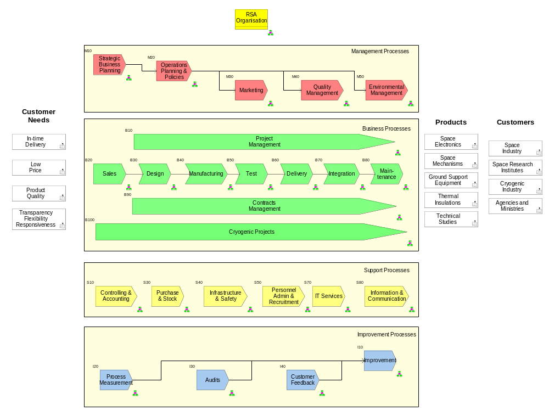
RSA’s former main process map (in ARIS)

Slide 12
Why to change the process modelling tool (from ARIS to stages)
Trigger
September 2012: Start of the company-wide improvement project “LOCO” (Logistic- and Configuration Management) at RSA.
Goals
To improve the supply chain and the document management by introducing PLM (Product Lifecycle Management) and to become in addition certified according to the Aerospace Standard EN 9100.
The Process Modelling Tool Issue
Software AG (new owner of IDS Scheer AG) no longer supported the “old ARIS architecture”. By keeping ARIS as the tool for process modelling RSA would have had to upgrade to the “new ARIS architecture” (business process modelling suite).

Slide 13
Why to change the process modelling tool (from ARIS to stages)
The Process Modelling Tool Issue (ctd)
Further findings:
  The offered new ARIS tool suite was expensive.
  Very poor support from the vendor during the proposal/offer phase for the new ARIS tool suite.
  In the frame of the presentation of the new ARIS tool suite it turned out that the following main weaknesses still remain:
    no possibility for user-friendly compliance checks
    cumbersome process tailoring, e.g. for application in projects
    restricted possibility for description of roles and work products
    focus of ARIS is general business process modelling, not taking into account specifics of technical organisations
→ Therefore we did a tool research, which led us to stages, with which we hope to overcome these weaknesses!

Slide 14
Introducing stages - first steps
Participation in a webinar, which are regularly offered by Methodpark
Definition of requirements for the introduction of stages and the process conversion from ARIS to stages
Three additional customised webinars with different participants on our side
After these webinars and the following proposal phase we ordered a few Methodpark consultant days (for workshop and training at RSA) and process modelling/viewer licences.
In the frame of the stages workshop we defined together with Methodpark:
  the concept for process distribution
  the metamodel

Slide 15
Conversion of the ARIS processes to stages
In ARIS we used the following (main) models:
eEPC - extended Event-driven Process Chain
VAC - Value Added (process) Chain
OU - Organisational Unit
These correspond in stages to (by using a customised metamodel):
Process (for this we use the same elements as in ARIS and also others)
Process chain
Roles
During the introduction of ARIS we issued a detailed convention handbook for process modelling, which has to be followed for process design/update.
Unfortunately this was not enforced strictly enough in the following years in the frame of process design/update.
→ This increased the effort for process conversion (to make them “readable”).

Slide 16
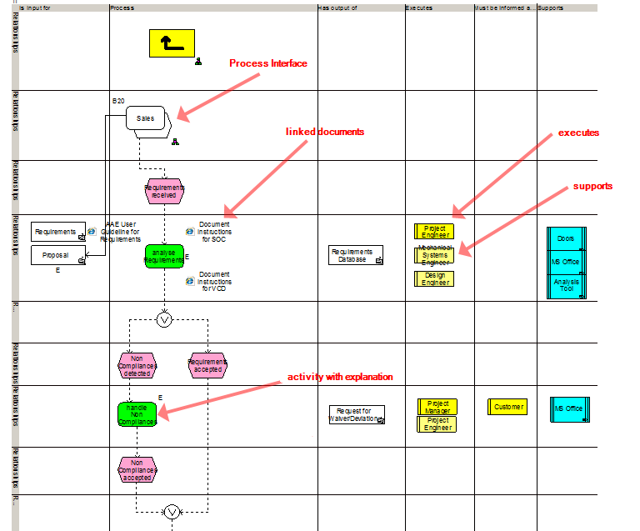
Problems in process conversion (1)
(example: excerpt of the Requirements Engineering process in ARIS)
Process interfaces (too much)
Process roles (executes, supports), differentiation only by colors

Slide 17
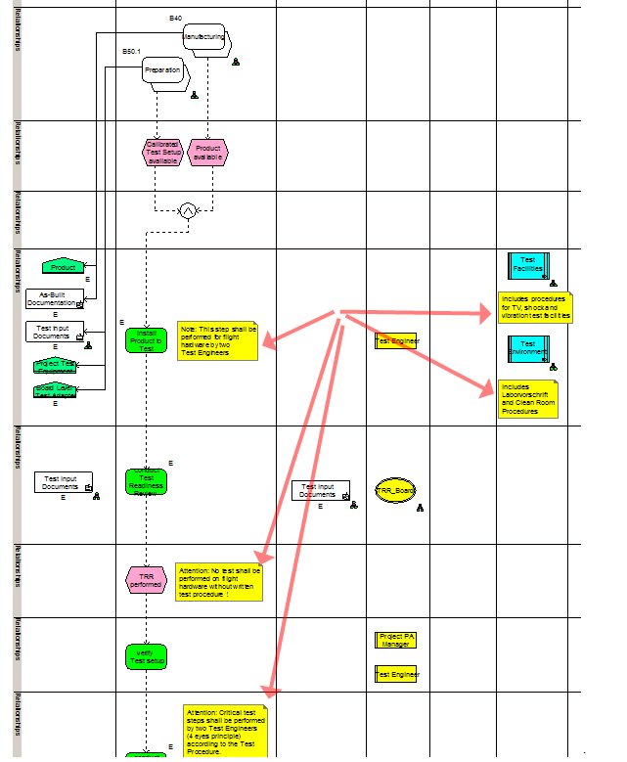
Problems in process conversion (2)
(example: excerpt of a test sub-process)
Notes in form of “post-its” are in ARIS a simple method for emphasizing additional issues of process activities → but they are a “nightmare” for converting processes, because they are lost during conversion.

Slide 18
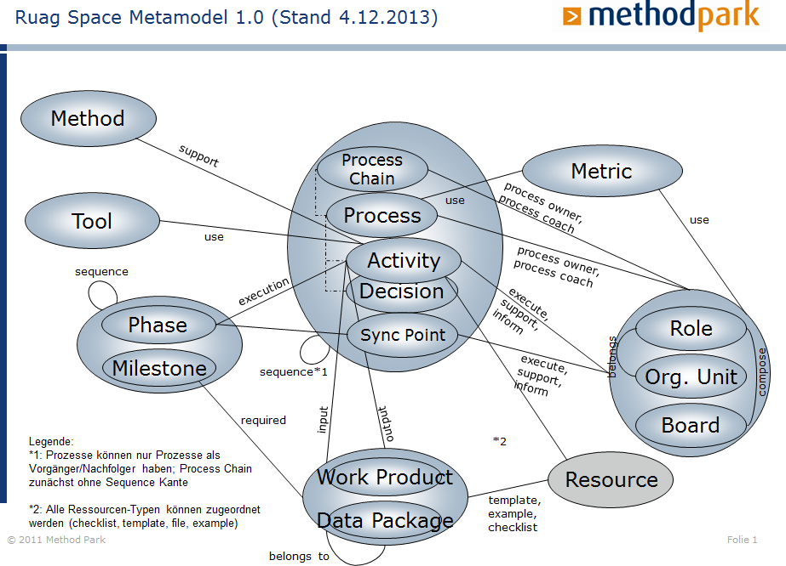
A main strength of stages: Metamodel is directing the process designer

Slide 19
Process “homeland” and process distribution (1)
Management Processes
Generic Process Pool
“Homeland of all processes”
All processes are maintained here (created, modified, deleted). The Generic Process Pool is a Core Processes “Workspace” that is inherited on the PDPs.
Processes
Work Products
Roles
Business Processes
Support Processes
Product Development Process (PDP)
In the individual PDPs, only processes, roles and work products which are needed in a certain business and production area (e.g. for space electronics) are available. The unneeded Processes, Roles and Work Products are “removed”
Project Management
Engineering
Processes
Work Products
Roles
Supply Chain
Support
Project Management
Project
For a project, the whole PDP (including standard processes for a business/production area) is copied. In this “Project Workspace” you can tailor according to your “Project Needs“.
N o t y e t a p p l i e d
Engineering
Processes
Work Products
Roles
Supply Chain
Support

Slide 20
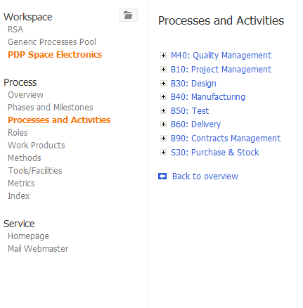
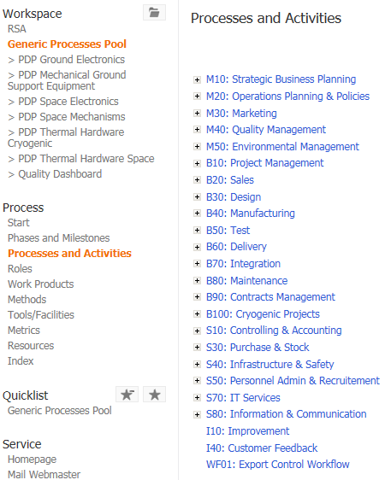
Process “homeland” and process distribution (2)
The Generic Process Pool currently comprises:
23 main processes
1 workflow
75 sub-processes (1st level) and 61 sub-processes (2nd level)
Note: In ARIS we only had a couple of processes less!
Generic Process Pool Space Electronics
tailoring
Space Electronics
processes which are only used in this PDP are displayed here. The other processes are “removed”.

Slide 21
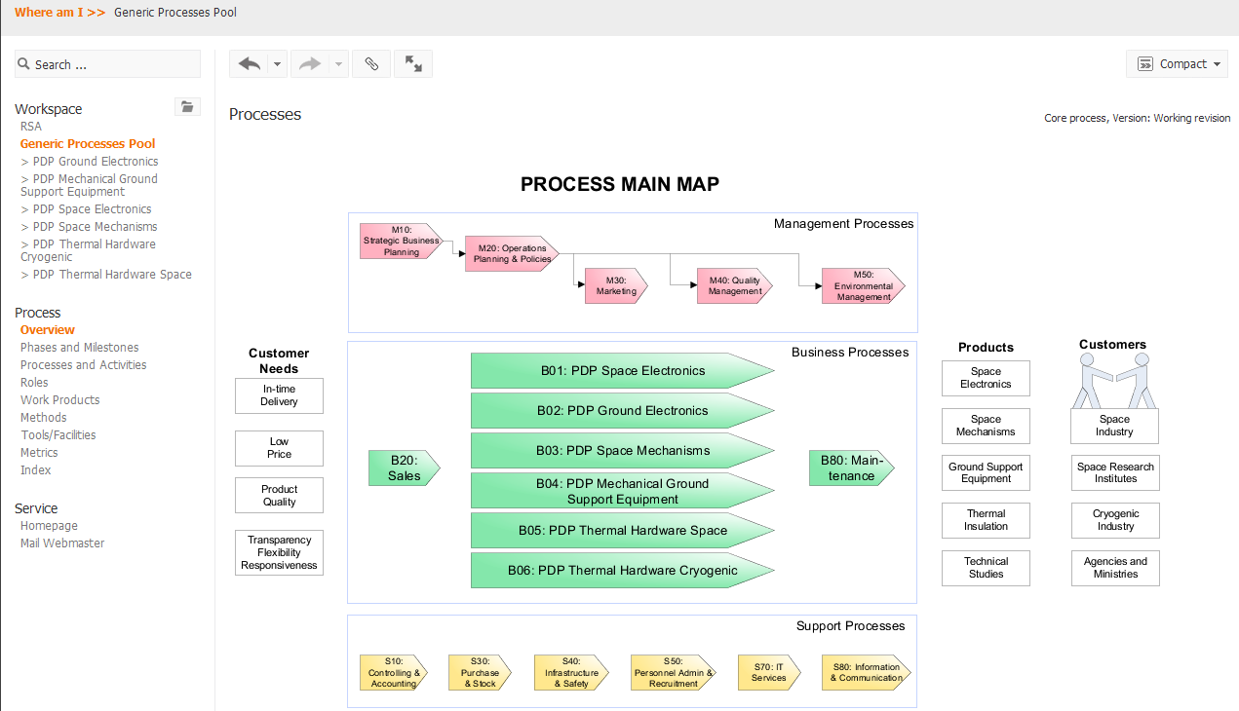
RSA’s actual process main map

Slide 22
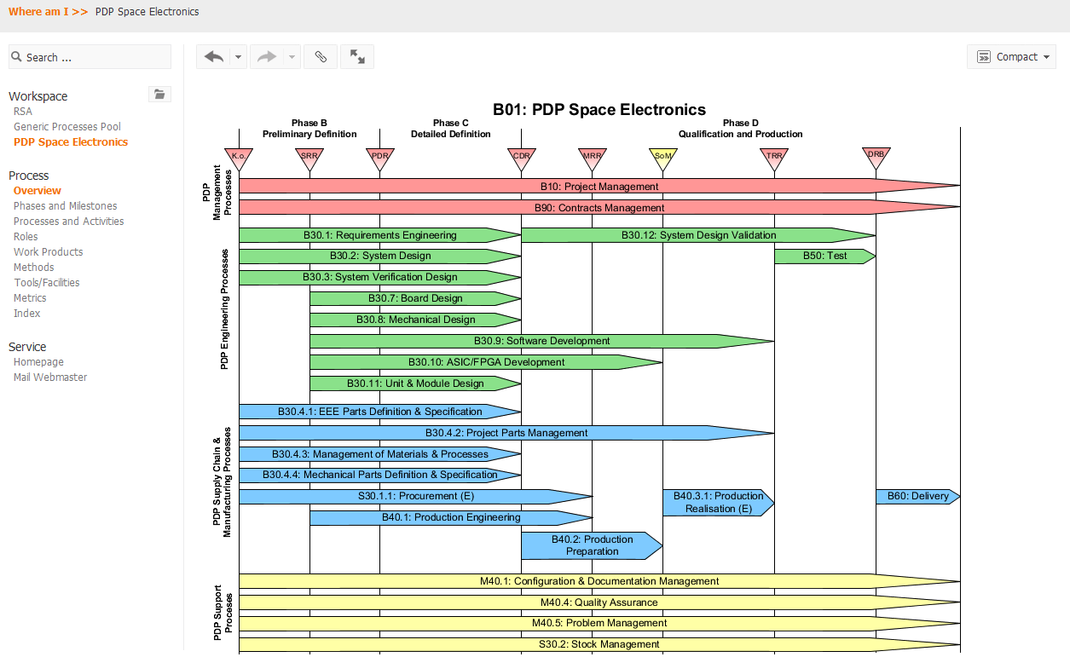
Concept of PDPs
The PDP is a (sub) process map, to which processes of the Generic Process Pool are assigned.

Slide 23
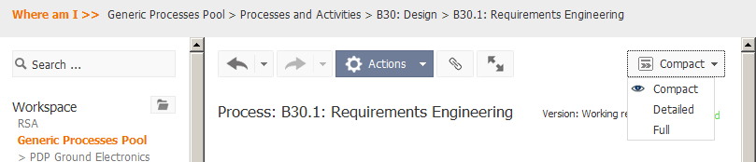
3 different process views for different audiences
Our stages application currently comprises three process views:
  Compact
    Compact overview of a process (“management view”)
  Detailed
    Role-based view of a process (“swimlane view”)
    Well suited for training of staff
  Full
    “Usual” top down view of “process flows” (“flowchart view”)
    Inputs/outputs/roles are displayed to each activity

Slide 24
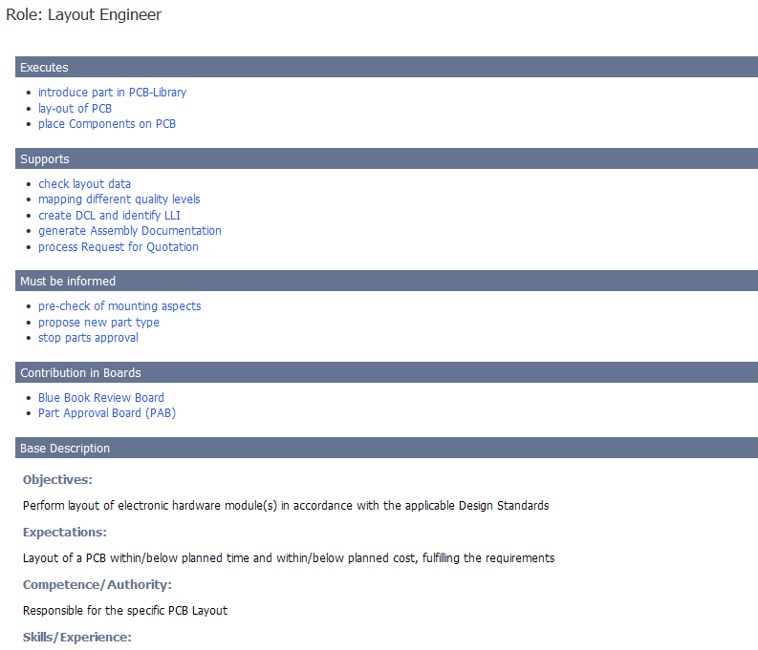
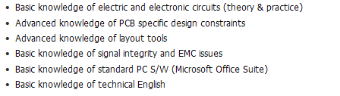
Role description
(using the role “Layout Engineer” as example)
The activities executed by the role “Layout Engineer”.
The activities supported by the role “Layout Engineer”.
The activities are automatically generated by the processes.
The activities about which this role must be informed.
Here is displayed whether this role collaborates in a board.
The general description of this role.

Slide 25
Current and upcoming challenges
For Process Owners and Coaches
Additional standard(s), to be compliant with (e.g. OHSAS 18001 (ISO 45001))
Build up a Wiki
Clean-up of role descriptions
Design of “workflows” showing the sequence of process activities, which are spread over several processes
Improvement of the process distribution concept (from one to several Generic Process Pools)
Improvement of the concept to link procedures/templates to work products
Introduce compliance check on “(sub-) process” and not on activity level
Process update/definition due to new revisions (2015) of EN 9100, ISO 9001 and 14001 standards
For Employees (user/viewer)
Revise the PMS entry page and sub-pages, because the amount of needed accesses to certain themes increases
Simplify import of process descriptions in project documents

Slide 26
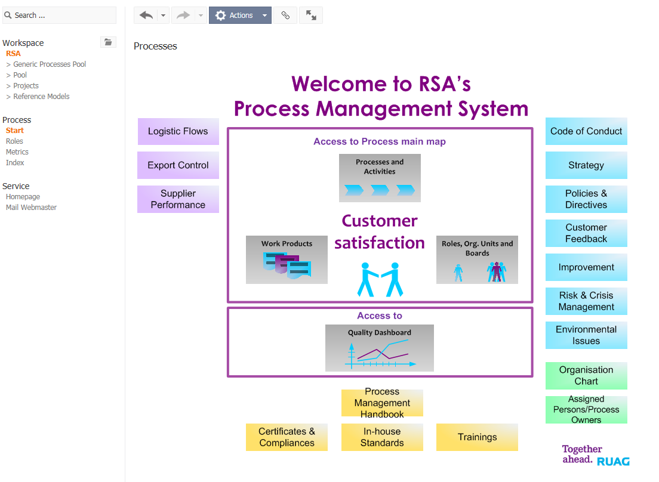
PMS – entry page

Slide 27
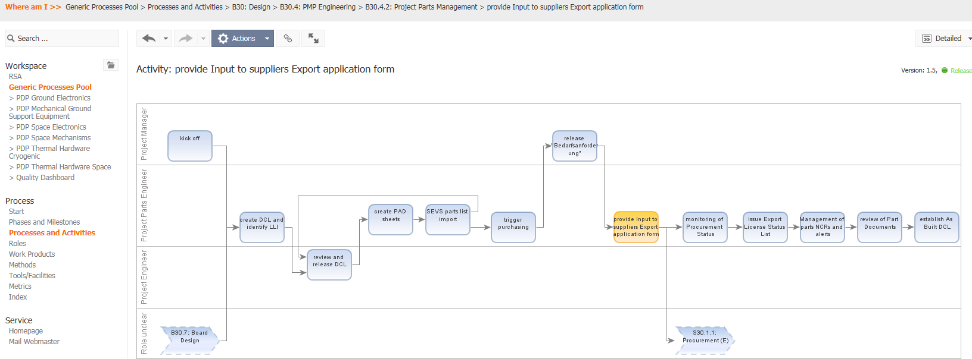
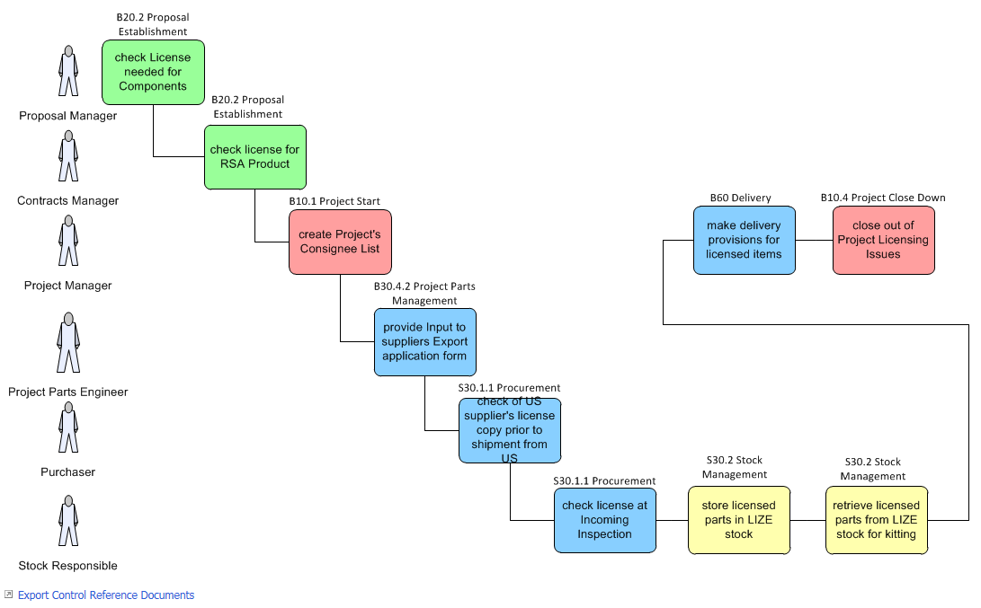
Increasing need on workflows
(e.g. for Export Control)

Slide 28
Thank you for your attention!
?

